Slide 1

Tailoring Course

Slide 2

Content
Introduction of topic
Languages used
Screenshots

Slide 3

Tailoring Classes in Pune.Enrolll into best stitching institutes, sewing courses to get certification and learn advanced techniques on blouse,dress.

Slide 4


The HyperText Markup Language.

Slide 5

CSS stands for Cascading Style Sheets.

Slide 6
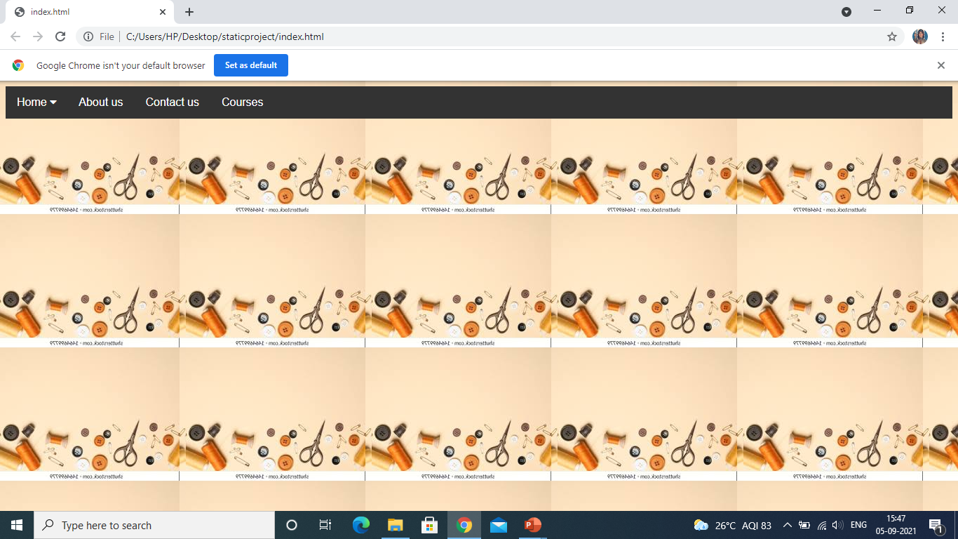

Slide 7
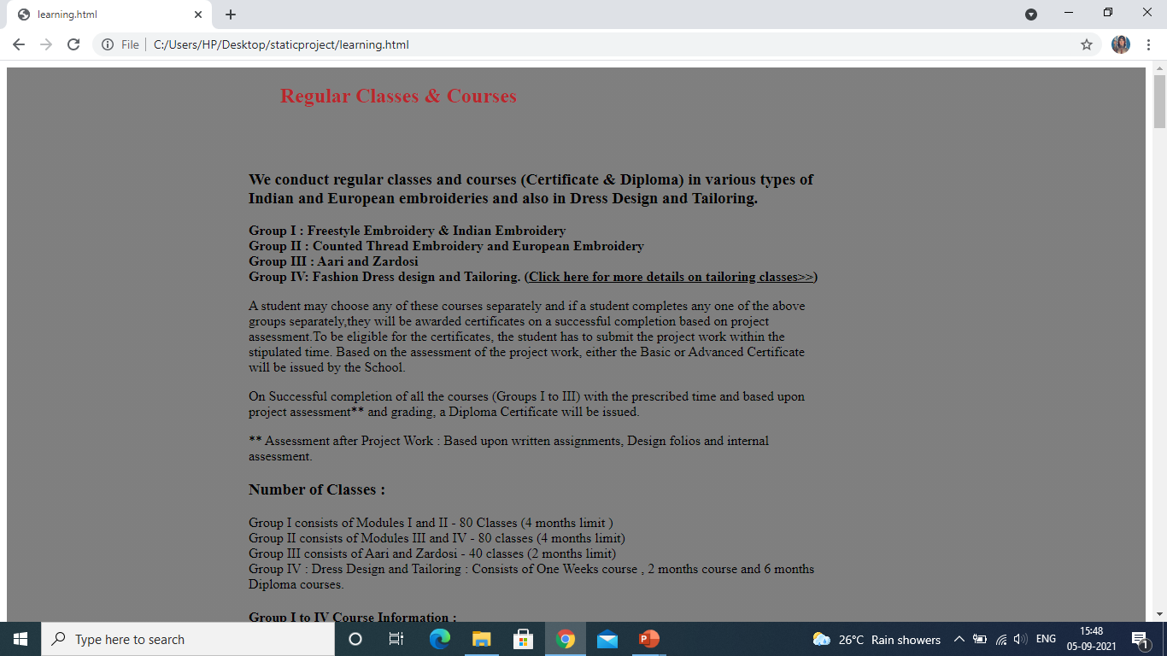

Slide 8
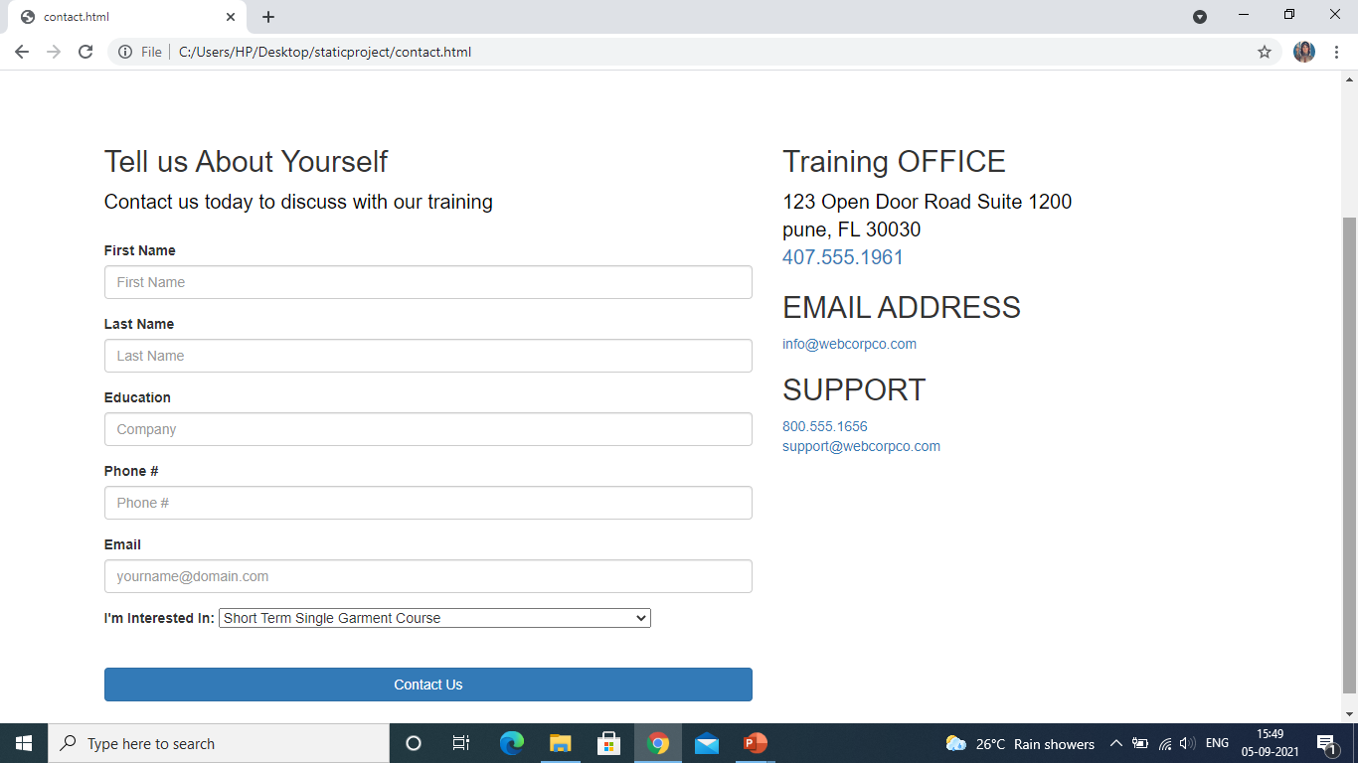

Slide 9
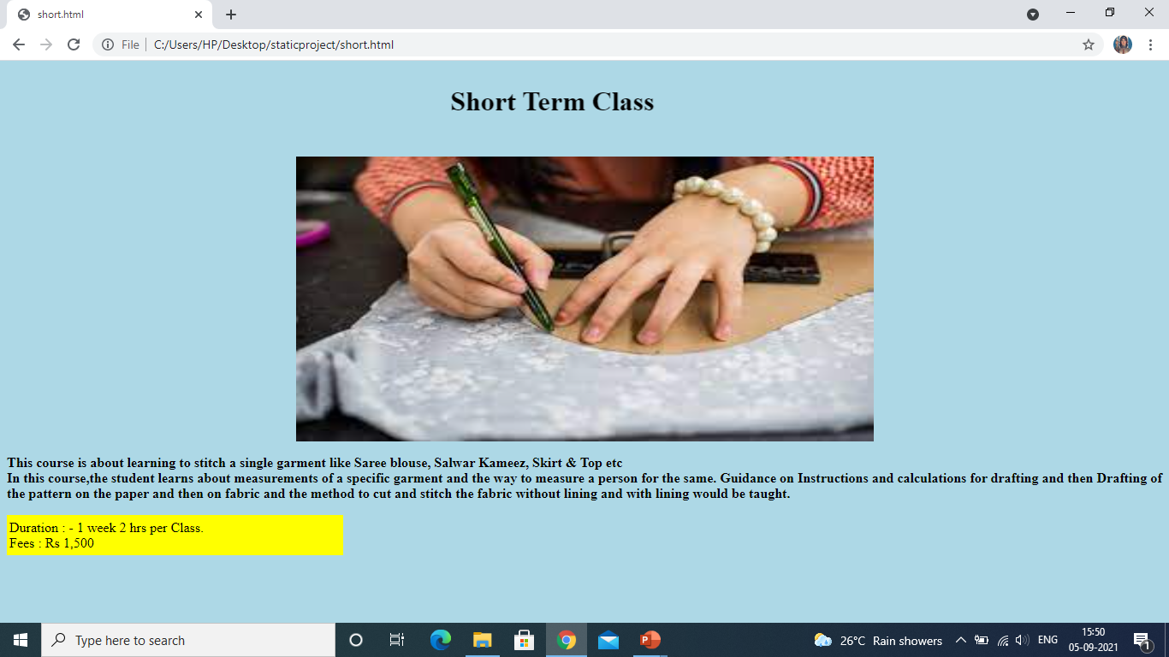

Slide 10
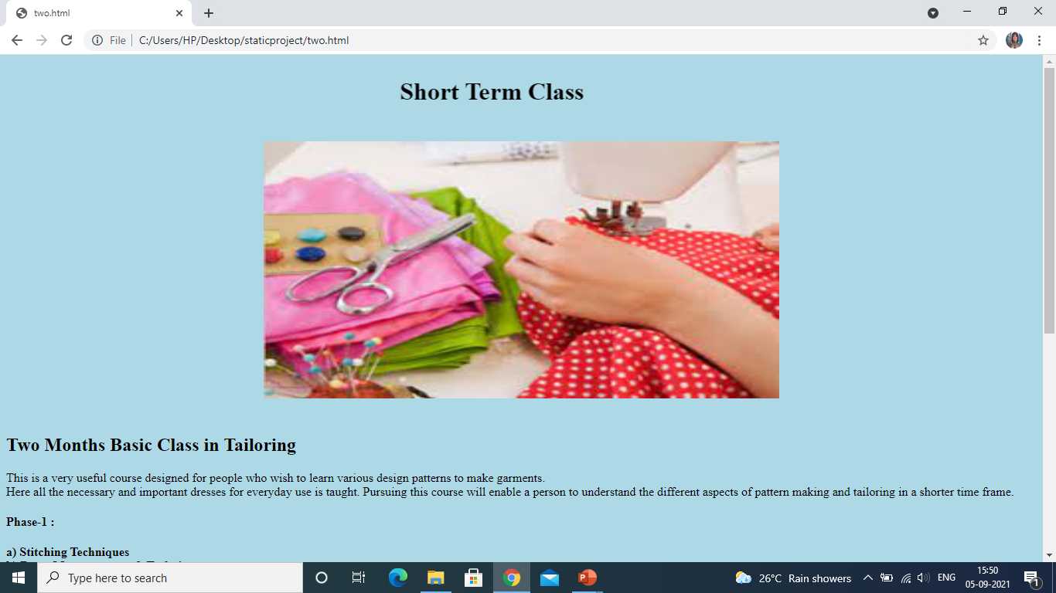

Slide 11
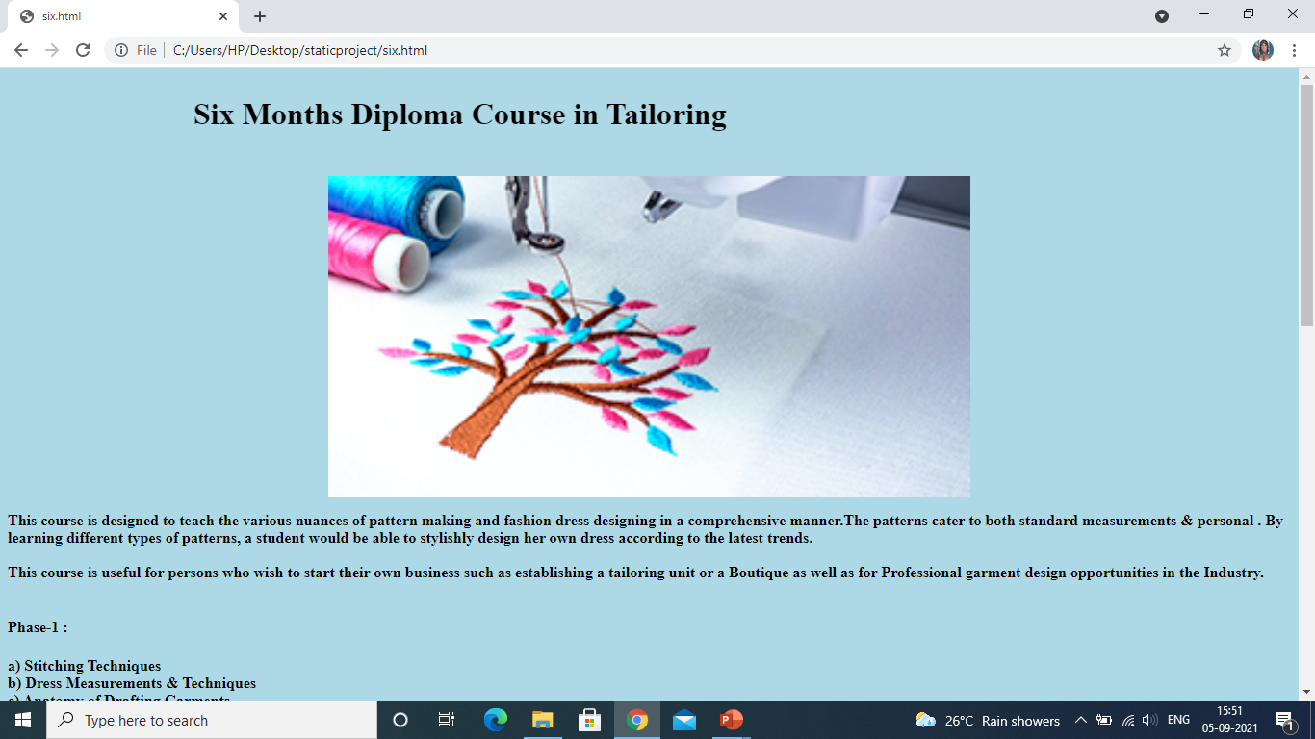

Slide 12





THANK YOU
Pratiksha Somnath Doke
7387888896
psdoke99@gmail.com
https://pratikshaedubridge.w3spaces.com/

